Slide 1
The Renaissance Period (1485-1660)
автор презентації – Манько В.А., учитель англійської мови Будянського технологічного ліцею Харківської районної ради Харківської області

Slide 2
This word, meaning rebirth, is commonly applied to the period of transition from the medieval to the modern word in Western Europe.
The Renaissance Period consisted of the:
the Early Tudor Age (1500-1557);
the Elizabethan Age (1558-1603);
the Jacobian Age (1603-1625);
the Caroline Age (1625-1642)

Slide 3
From 1485 to 1603, the royal House (family) of Tudor ruled England. Queen Elizabeth I, the last Tudor monarch, reigned from 1558 to 1603.
During the Elizabethan Age, the English explored and colonized distant lands. Wealth from the colonies poured into England. A newly rich merchants as well as the nobility wanted entertainment and fine art and were willing to pay for them. Writers, painters, and musicians flocked to London, making it a European cultural center. English writers produced some of the greatest poetry and drama in world literature

Slide 4
Elizabethan poetry- three chief forms of poetry flourished during this
lyric
blank verse
narrative poem
sonnet

Slide 5
LYRIC – a short poem that expresses a poet’s personal emotions in a songlike style. Thomas Campion wrote many beautiful lyrics in his “Books of Airs”; SONNET – 14-line poem with a certain pattern of rhyme and rhythm. Elizabethan poets wrote two types of sonnets, the Italian sonnet and English sonnet. The two types differed in the arrangement of the rhythm. Sir Thomas Wyatt introduced the sonnet from Italy into English literature in the early 1500s. The Earl of Surrey modified the form into English sonnet. Their verses were published in the collection commonly called “Tottel’s Miscellany”. William Shakespeare and Edmund Spenser wrote sonnet sequences – a group of sonnets based on a single theme or about one person. NARRATIVE POEM tells a story. In addition to sonnets, Shakespeare and Spenser wrote narrative poems. Shakespeare based his “Venus and Adonis” on a Roman myth. Spenser borrowed heavily from medieval romances. English poets translated many works from other literatures. The translation introduced blank verse into English literature. BLANK VERSE consists of unrhymed lines of 10 syllables, with every syllable accented. Many poets adopted this form.

Slide 6
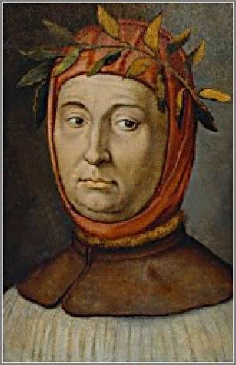
English poets at that time imitated foreign models, the most important of which was the sonnet, the poetic form which is originally Italian.
It was brought to perfection by the great Italian poet Francesco Petrarca (1304 – 1374). ( Petrarch is the English spelling of his name.)
A Petrarch sonnet is a poem of 14 lines: two quatrians ($-line stanzas) and two terzets (#-line stanzas).The rhythmic pattern of the quatrians is abba abba (the rhymes in both quatrians are the same); the rhymes of the terzets could vary: cde cde; cdc dcd; ccd eed.

Slide 7
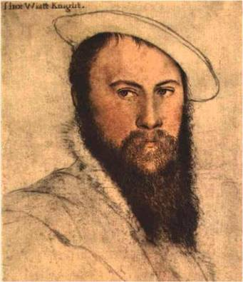
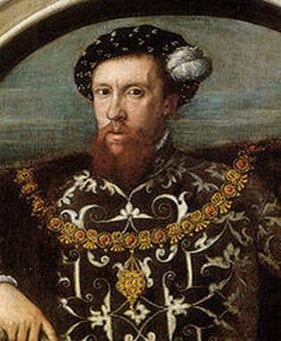
The outstanding English poets of the middle of the 16th century who were the first to bring the sonnet into English literature were
Sir Thomas Wyatt (1503 -1542)
Henry Howard, Earl of Surrey
(1517 -1547).

Slide 8
It is rather difficult to compose a sonnet observing the strict form and alteration of lines.
Besides, in a classical sonnet a thought is put forth in the first quatrian,
another thought (contradicting the first) in the second,
these two thoughts intersect in the first terzet, usually in the last line of the sonnet.
If the author is skilful enough, he makes the last line the most significant, this word is called the key of the sonnet.

Slide 9
Sir Thomas Wyatt’s most quoted poem is not, strictly speaking, a sonnet, but it may serve as an example of an elaborate verse form with a strictly observed rhyme pattern:
The Lover’s Appeal
And wilt thou leave me thus?
Say nay! Say nay! For shame!
To save thee from the blame
Of all my grief and grame.
And wilt thou leave me thus?
Say nay! Say nay!

Slide 10
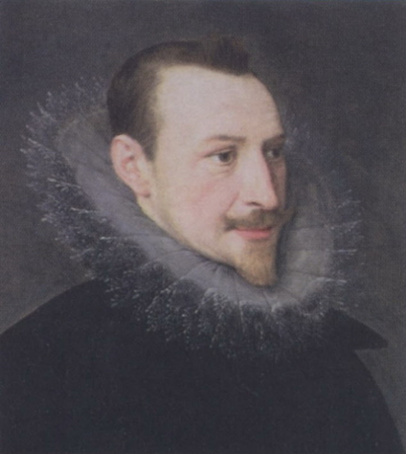
Among “non-aristocratic” authors was the greatest poet of the English Renaissance Edmund Spenser (1552 -1599).
His father was a cloth-maker, but Edmund had an opportunity of going to Cambridge as a “sizar”- a poor student who paid less for his education than others, but had to serve the richer students during meals. In that way he acquired some intellectual friends, Sir Philip Sidney among them.

Slide 11
ELIZABETHAN DRAMA
In 1576, James Burbage built England’s first playhouse, called The Theatre, in suburb of London. After it other playhouses were constructed, which rapidly increased the popularity of drama.
Elizabethan drama was noted for its passion and vitality. Thomas Kyd’s play “The Spanish Tragedy”, which was one of the earliest Elizabethan dramas, is filled with scenes of violence and madness and set a pattern for themes of murder and revenge in later plays.

Slide 12
A group of leading Elizabethan playwrights were known as the “University Wits”, because they had attended the famous English universities at Oxford and Cambridge.
These playwrights included
ROBERT GREEN,
CHRISTOPHER MARLOWE,
and GEORGE PEELE
(was the most important dramatist among Wits). He wrote tragedies that center on strong personalities: “Tamburlaine the Great” and “The Tragical History of Doctor Faustus”

Slide 13
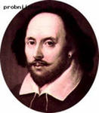
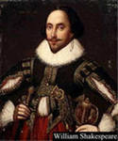
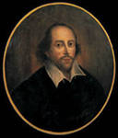
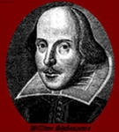
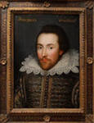
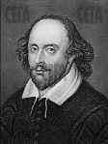
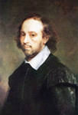
The greatest Elizabethan playwright was WILLIAM SHAKESPEARE

Slide 14
The two major groups of poets during the Stuart period were:
METAPHYSICAL POETS
used comparatively simple language, but they often created elaborate images called conceits
John Donne
Abraham Cowley
George Herbert
Henry Vaughan
CAVALIER POETS
wrote dashing love poetry
Thomas Carew
Robert Herrick
Richard Lovelace
Sir John Suckling

Slide 15
Jacobian Drama
the name given to the plays written during the reign of James I. These tragedies reflected Elizabethan drama, especcially in such characteristics as violent action, spectacle, and the revenge theme.
Satiric comedies, which poked fun at various subjects, were also popular.

Slide 16
PROSE WRITING
In 1604, King James I authorized a group of scholars to prepare a new English version of the Bible. It appeared in 1611 and became known as the “King James Version or Authorized Version”. This Version was a landmark in the development of English prose. Its elegant yet natural style had enormous influence on English-speaking writers.
Many authors wrote philosophical works during the early and mid-1600s. Donne composed a series of meditations on sickness, sin, and death. Sir Thomas Brown and Jeremy Taylor wrote works noted for their beautiful prose style. In “Religio Medicini”, Browne gave his learned opinions on a broad variety of subjects, including miracles and wichtcraft.

Slide 17
ВИКОРИСТАНі ДЖЕРЕЛА:
1. Гордєєва Н.М. Англійська література: Навч. посібник для шкіл з поглибл. вивч. англ. мови. --- К. : Равлик, 1998. ---286 с.
Малюнки та зображення:
http://probniishar.in/?bee=pictures-of-shakespeare's
http://urupin.livejournal.com/160762.html
http://www.npr.org/2011/01/04/132650791/bringing-the-bard-behind-bars-in-south-africa
http://club.rc-mir. com/topic2821324_50 html
http://www.books.ru/shop/ibooks/1978185794294
http://www.ec-dejavu.net/p-2/Petrarch.html
http://lalaluvu.com/page/2/
http:www.thepoetsgarret.com/elizabethan/jun2.html
http://www.artchive.com/web_gallery?J/John-de-the-Elder-Critz/Portrait-of-Sir-Philip-Sidney-(1554-86)-c1620.html
http://nahaplaneta.pp.ua/raznoe-2/kultura+iskusstvo/anlijskaya-literatura-v-period-renessansachast-4

